Slide 1
SECURING SURVEILLANCE IMAGES FOR I.O.T DEVICES

Slide 2
Presented By:-
Name | Enrolment Number | Roll Number
Aditi Das | AU/2017/02/0000958 | UG/02/BTCSE/2017/024
Shatavisha Paul | AU/2017/02/0001133 | UG/02/BTCSE/2017/054
Pritha Bala | AU/2017/02/0001160 | UG/02/BTCSE/2017/057
Neelanjana Bandyopadhyay | AU/2017/02/0001226 | UG/02/BTCSE/2017/071
UNDER THE GUIDANCE OF
Mr. PABAK INDU
Assistant Professor
Department of Computer Science & Engineering
Adamas University

Slide 3
Contents
Steganography
IoT Attacks
Recent IoT Attacks carried out
Literature Survey
Proposed Method
Experimental Results
Comparison with existing approach
Conclusion & Future Scope
References

Slide 4
1. steganography

Slide 5
What is Steganography?
Steganography is the practice of concealing a message within another message or a physical object. [1]
The word steganography comes from Greek steganographia, which combines the words steganós meaning “covered or concealed”, and graphia meaning “writing”. [1]
The use of steganography can be combined with encryption as an extra step for hiding or protecting data. [2]

Slide 6
2. IoT Attacks

Slide 7
What is IoT Attack?
The IoT attack surface is the sum total of all potential security vulnerabilities in IoT devices and associated software and infrastructure in a given network, be it local or the entire Internet. [3]
Internet of Things (IoT) devices were exploited by cybercriminals and turned into a rogue and malevolent army. [4]
According to many security experts, our dependence on Internet-connected technology is outpacing our ability to secure it. [3]

Slide 8
3. Case studies on recent I.o.t attacks

Slide 9
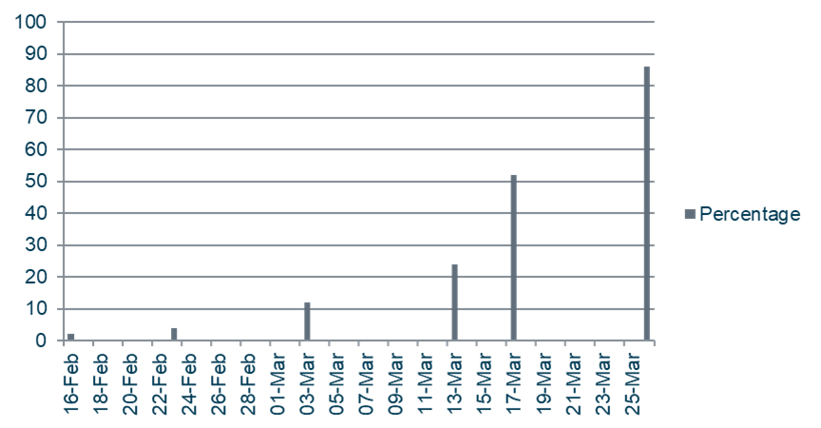
Recent IoT Attack
Hackable Internet of Things (IoT) devices are on full display at the RSA Conference 2020 in SAN FRANCISCO. The smart vacuum cleaner Trifo Ironpie M6, has several high-severity flaws that open the device to remote attacks. [5]

Slide 10
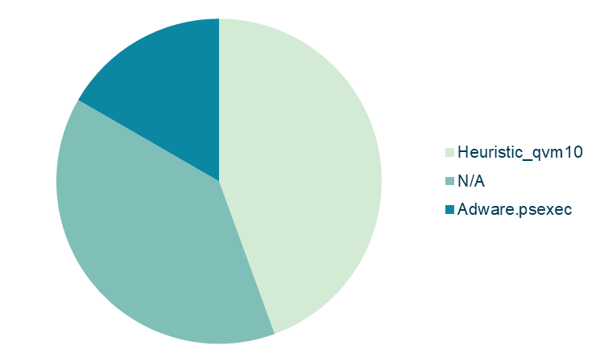
Recent IoT Attack
In SAN JOSE, California, Feb. 5, 2020 the global leader in cyber deception technology has identified a new malware campaign TrapX Security, specifically targeting around 200 million IoT devices using Windows 7 at various global manufacturing sites. [6]

Slide 11
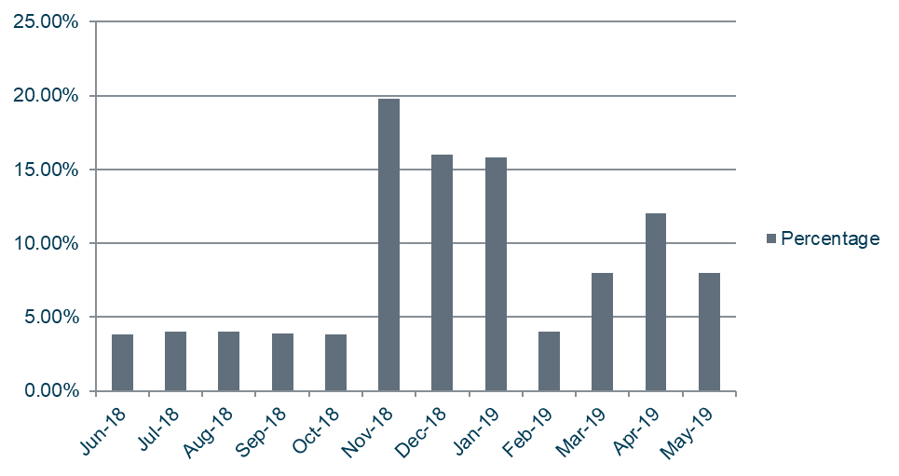
Recent IoT Attack
Mirai is a malware that turns networked devices running Linux into remotely controlled bots that can be used as part of a botnet in large-scale network attacks. In September 2016, the authors of the Mirai malware launched a DDoS attack on the website of a well-known security expert. [7]

Slide 12
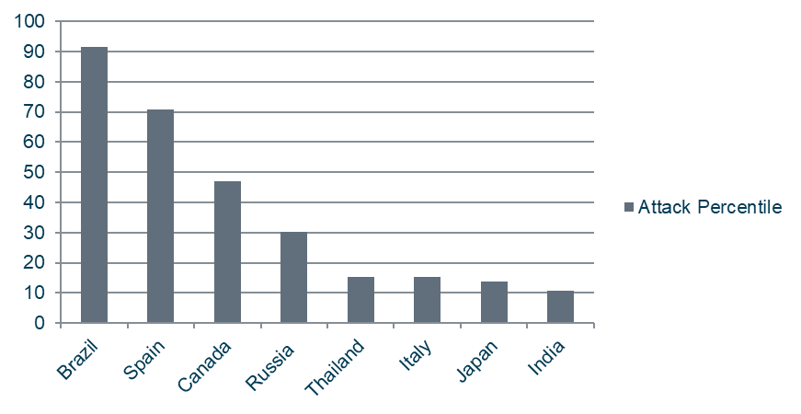
Recent IoT Attack
A 14-year-old hacker used a new strain of malware in June to brick up to 4,000 insecure Internet of Things devices – before abruptly shutting down his command-and-control server. The malware, dubbed Silex, targeted insecure IoT devices and rendered them unusable much like the BrickerBot malware in 2017. [8]

Slide 13
4. Literature Survey

Slide 14
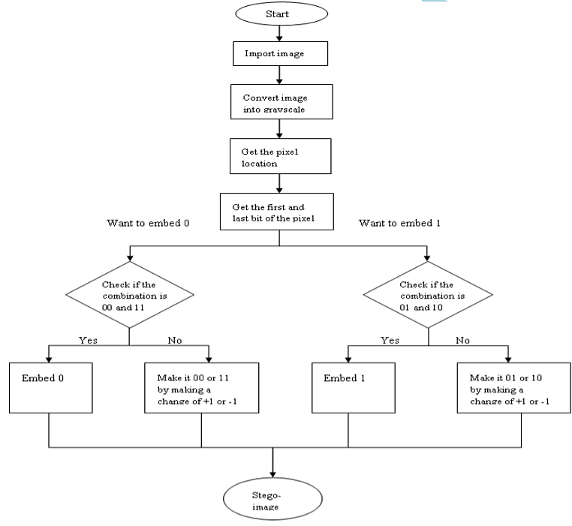
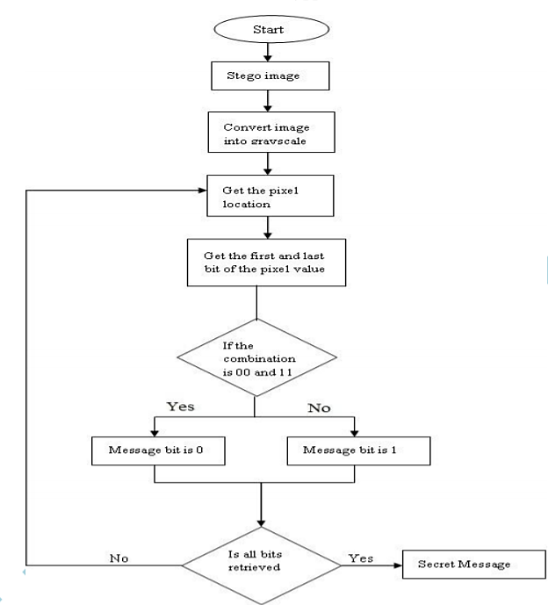
A New Method for Image Steganography Using LSB and MSB [9]
This paper proposes a new information hiding method which used the concept of spatial domain for hiding and retrieval of the information and used the LSB & MSB pixels for hiding and retrieval of the message.
Flowchart depicting insertion of message bits
Flowchart depicting retrieval of message bits

Slide 15
Secure and Robust Image Steganography Using a Reference Image as Key [10]
In this paper, a steganography scheme has been proposed that uses a reference image as an encryption key. This scheme encrypts the secret bits using randomly selected reference image bit-plane bits and then embeds into cover image LSBs.
Secret message test printed on black canvas
Converted into a binary B/W image containing secret message text
Encrypted secret image using reversible XOR operation
Stego image with encrypted secret image bits embedded into LSBs of cover image
Selected reference image bit plane(s)
Cover image
Stego-Image Generation: Encrypt and Embed
Stego-image
Extracted LSB bit plane(s) = encrypted secret image
Decrypted secret image using reversible XOR operation
Secret B/W image with secret message text
Stego-key
Selected reference image bit plane(s)
Secret message Extraction and Decoding

Slide 16
Internet of Things: Securing Data using Image Steganography [11]
This paper suggests a secure scheme on using image steganography as a security mechanism in addition with a home server to secure the transmitted data from the IoT device to the other devices, either in LAN or WAN networks.
IP CAMERA
HOME SERVER
Sensitive data transmission within LAN with steganography
USER FACE IMAGE (ORIGINAL IMAGE)
STEGO IMAGE (ORIGINAL IMAGE EMBEDDED IN COVER IMAGE)
Steganography technique
RANDOM IMAGE (COVER IMAGE)
Inverted LSB image steganography is suggested to use in this scheme.

Slide 17
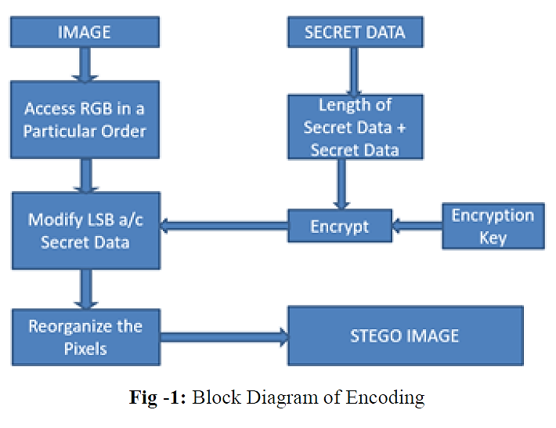
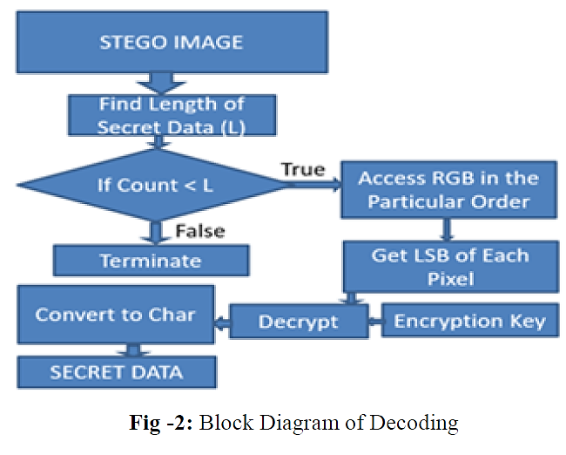
Image Steganography Using Modified LSB [12]
This paper proposes Least significant bit (LSB) insertion method. It is a simple yet efficient approach for embedding data into a digital image. The simplest steganography technique inserts the bits of the data directly into the least significant bits, i.e., LSB of the cover-image in a particular sequence.
Block Diagram of Encoding
Block Diagram of Decoding

Slide 18
5. Proposed Method

Slide 19
Embedding process:
For example, the secret message is ‘Hello World!!’.
Hello World!!
[72, 101, 108, 108, 111, 32, 87, 111, 114, 108, 100, 33, 33]
Secret Message
ASCII Format
Conversion of ASCII Format to Binary Format
[0, 1, 0, 0, 1, 0, 0, 0, 0, 1, 1, 0, 0, 1, 0, 1, 0, 1, 1, 0, 1, 1, 0, 0, 0, 1, 1, 0, 1, 1, 0, 0, 0, 1, 1, 0, 1, 1, 1, 1, 0, 0, 1, 0, 0, 0, 0, 0, 0, 1, 0, 1, 0, 1, 1, 1, 0, 1, 1, 0, 1, 1, 1, 1, 0, 1, 1, 1, 0, 0, 1, 0, 0, 1, 1, 0, 1, 1, 0, 0, 0, 1, 1, 0, 0, 1, 0, 0, 0, 0, 1, 0, 0, 0, 0, 1, 0, 0, 1, 0, 0, 0, 0, 1]
Binary Format

Slide 20
Embedding process:
Convert into 3x3 block matrix
Read seed pixel
(Even or Odd)
Cover Image
If odd
If even
The operation is performed on the topmost row of the 3x3 matrix
The operation is performed on the bottommost row of the 3x3 matrix
The modified matrix is obtained
Stego Image

Slide 21
Extraction process:
Convert into 3x3 block matrix
Read seed pixel
(Even or Odd)
Stego Image
If odd
If even
The operation is performed on the topmost row of the 3x3 matrix
The operation is performed on the bottommost row of the 3x3 matrix
Binary message list is obtained
Secret Message
ASCII Message List

Slide 22
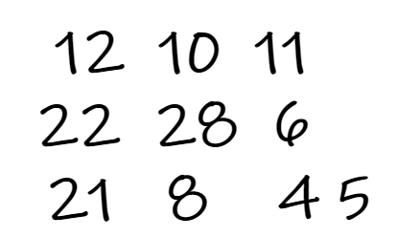
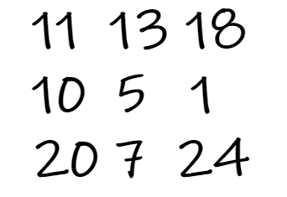
Embedding Operation
Below is the demonstration of the operation performed on a random matrix where the random binary string 101011 (say) is embedded.
|-3|=3
|-2|=2
|-5|=5
13
4
3
9
10

Slide 23
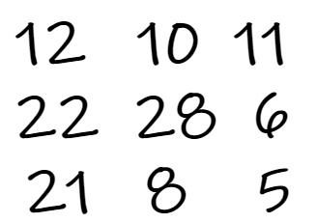
Extraction Operation
Below is the demonstration of the operation performed on a random matrix where the binary message list [1,0,…] is obtained.
|-3|=3 (odd)
|-2|=2
|-5|=5
13
3
10 (even)

Slide 24
6. Experimental Results

Slide 25


Output after Embedding
Hello World!!
Secret Message
Cover Image
Stego Image

Slide 26
Output after Extraction
Hello World!!
Extracting Secret message
Secret Message
Stego Image

Slide 27
Message Length | KL Divergence | Correlations | Entropy | PSNR | MSE | RMSE
0.1 | 0.1176 | 0.0884 | 7.6674 | 3.7198 | 2.76E+04 | 5.6087
0.2 | 0.117638 | 0.088433 | 7.667444 | 3.719785 | 2.76E+04 | 5.6087
0.3 | 0.117638 | 0.088433 | 7.6674 | 3.7198 | 2.76E+04 | 5.6087
0.4 | 0.117638 | 0.088433 | 7.667444 | 3.719785 | 2.76E+04 | 5.6087
0.5 | 0.117638 | 0.088433 | 7.667444 | 3.7198 | 2.76E+04 | 5.6087
0.6 | 0.117638 | 0.088433 | 7.667444 | 3.719785 | 2.76E+04 | 5.6087
0.7 | 0.117638 | 0.088433 | 7.6674 | 3.7198 | 2.76E+04 | 5.6087
0.8 | 0.1176 | 0.0884 | 7.6674 | 3.7198 | 2.76E+04 | 5.6087
0.9 | 0.117638 | 0.088433 | 7.667444 | 3.7198 | 2.76E+04 | 5.6087
1.0 | 0.117638 | 0.088433 | 7.667444 | 3.719785 | 2.76E+04 | 5.6087
Various Images Similarity Metrics

Slide 28
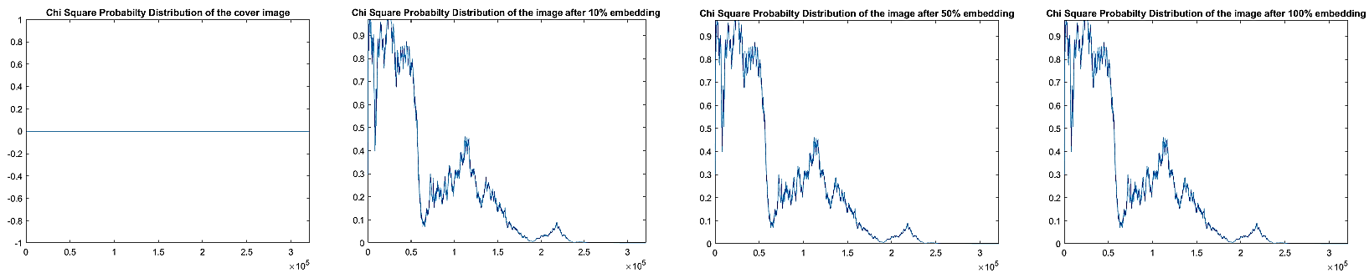
Chi Square Probability Distribution of Cover and Stego Images (10%, 50%, 100%)
(a)
(b)
(c)
(d)
Chi Square Probability Distribution of the cover image
Chi Square Probability Distribution of the image after 10% Embedding
Chi Square Probability Distribution of the image after 50% Embedding
Chi Square Probability Distribution of the image after 100% Embedding

Slide 29
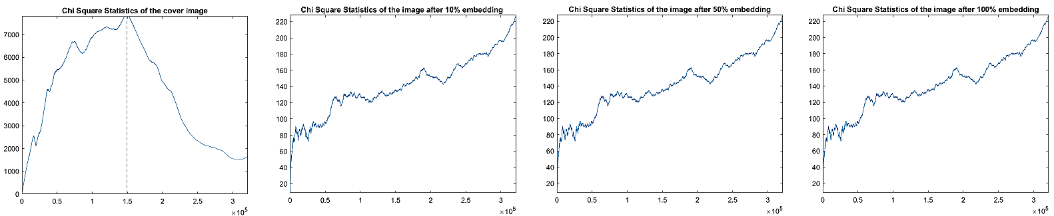
Chi Square Statistics Distribution of Cover and Stego Images (10%, 50%, 100%)
(a)
(b)
(c)
(d)
Chi Square Statistics of the cover image
Chi Square Statistics of the image after 10% Embedding
Chi Square Statistics of the image after 50% Embedding
Chi Square Statistics of the image after 100% Embedding

Slide 30
7. comparison with existing approach

Slide 31
Image Steganography Using Modified L.S.B [12] | A New Method for Image Steganography Using LSB and MSB [9] | Internet of Things: Securing Data using Image Steganography [11] | Secure and Robust Image Steganography Using a Reference Image as Key [10] | Proposed Method
Low embedding capacity due to single bit mapping technique | Moderate embedding capacity due to double bit mapping technique | Quite high embedding capacity due to use of inverted LSB image steganography | High embedding capacity due to the use of multiple bit planes | Moderate embedding capacity due to mapping techniques
Secrecy of hidden data is high due to a pre-decided RGB order of LSB modification | Secrecy of hidden data is quite high due to the use of spatial domain | Secrecy of hidden data is quite high due to randomized selection of LSBs and addition of home server within IoT network | Secrecy of hidden data is very high due to the use of reference image and random combination of bit planes for encoding | Secrecy is moderate based on seed value mapping and mathematical model
Not tested against various image attacks | Not tested against various image attacks | Not tested against various image attacks | Tested against random noise addition | Not tested against various image attacks
Tested against various steganalysis methods such as MSE, PSNR, UIQI and SSIM, RGB Histogram | Tested against various steganalysis methods such as PSNR and MSE | Not tested against various steganalysis methods | Tested against various steganalysis methods such as Hiding capacity, MSE, PSNR, SSIM and Histogram | Tested against various steganalysis methods such as KL Divergence, Correlations, Entropy, PSNR, MSE, RMSE

Slide 32
8. Conclusion & future scope

Slide 33
Conclusion
We had done the image steganography by slightly modifying image matrix according to the secret message which is in binary form. The purpose of this simple proposed method is to embed the secret message into the cover image in such a way so that the third party cannot suspect that there is a transmission of secret message between sender and receiver. Also, the minor change in image matrix will not create any noticeable change in the cover image. Thus, we have successfully implemented image steganography. The technology used for this method is OpenCV-Python.

Slide 34
Future Scope
We plan to implement the proposed method on a hardware platform in the future when the COVID-19 pandemic is behind us. Although, we have successfully implemented image steganography through the existing algorithm, the algorithm for embedding the secret text into the cover image needs to be further modified. We also need to increase our payload capacity. We will plan the required mathematical model to do so. In our current method, we first need to convert the secret message into its ASCII value. Each ASCII value needs to be further converted into an 8-bit binary code for which we need to make changes for embedding the message in all the 8 matrices for the 8-bit binary code. This becomes a tedious job and reduces the embedding capacity of the code. Instead, we can directly convert the secret message into its binary format which will enhance the embedding capacity compared to the current method. These are the changes we will make in the future and will incorporate proper IoT hardware device after the pandemic.

Slide 35
9. References

Slide 36
References
[1] https://en.wikipedia.org/wiki/Steganography Accessed on 11 May,2021
[2] https://searchsecurity.techtarget.com/definition/steganography Accessed on 12 May,2021
[3] https://internetofthingsagenda.techtarget.com/definition/IoT-attack-surface Accessed on 20December, 2020
[4] https://www.welivesecurity.com/2016/12/19/iot-attacks-10-things-you-need-to-know/#:~:text=Internet%20of%20Things%20(IoT)%20devices,%2C%20Reddit%2C%20Spotify%20and%20PayPal Accessed on 20December, 2020
[5] https://threatpost.com/vacuum-cleaners-baby-monitors-and-other-vulnerable-iot-devices/153294/ Accessed on 1 July, 2020
[6] https://finance.yahoo.com/news/trapx-security-identifies-malware-campaign-130000671.html?guccounter=1 Accessed on 1 July, 2020
[7] https://www.iotforall.com/5-worst-iot-hacking-vulnerabilities/ Accessed on 2 july, 2020

Slide 37
References
[8] https://timesofindia.indiatimes.com/gadgets-news/14-year-old-teenager-creates-new-silex-malware-to-destroy-smart-devices/articleshow/69982962.cms#:~:text=Well%2C%20that%20is%20back%2C%20in,modems%20of%20BSNL%20broadband%20subscribers Accessed on 1 April 2021
[9] Gaurav, M., 2016. A New Method for Image Steganography Using LSB and MSB. International Journal of Recent Research Aspects ISSN, pp.2349-7688.
[10] Maji, G. and Mandal, S., 2019. Secure and robust image steganography using a reference image as key. International Journal of Innovative Technology and Exploring Engineering (IJITEE), 8(7), pp.2828-2839.
[11] Yin, J.H.J., Fen, G.M., Mughal, F. and Iranmanesh, V., 2015, December. Internet of Things: Securing data using image steganography. In 2015 3rd International Conference on Artificial Intelligence, Modelling and Simulation (AIMS) (pp. 310-314). IEEE.
[12] Bhaskar, A. and Acharya, M.U.K., IMAGE STEGANOGRAPHY USING MODIFIED LSB. 2013, pp.1-5.

Slide 38


